Slide 1
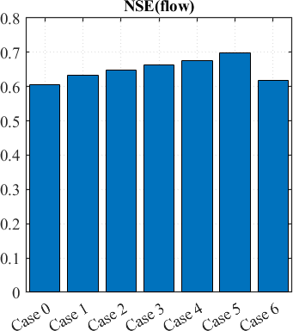
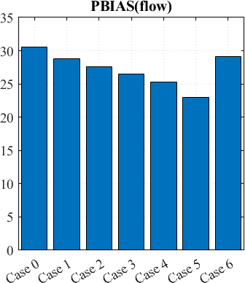
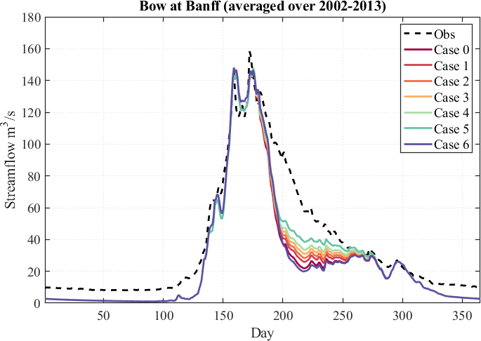
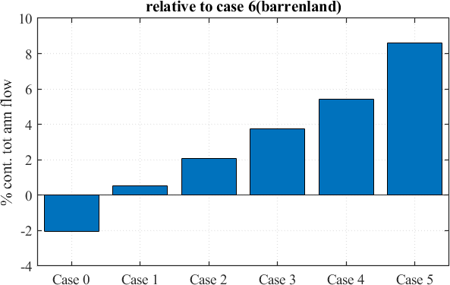

Updated MESH code with new parameterization of snow depth limit and snow density limit
ALVSI = Visible albedo of glacier
ALIRI = Infrared albedo of glacier
Case 0 = 0.95(ALVSI), 0.73(ALIRI)
Case 1 = 0.85(ALVSI), 0.56(ALIRI)
Case 2 = 0.75(ALVSI), 0.50(ALIRI)
Case 3 = 0.65(ALVSI), 0.43(ALIRI)
Case 4 = 0.55(ALVSI), 0.36(ALIRI)
Case 5 = 0.35(ALVSI), 0.23(ALIRI)
Case 6 = Replaced glacier with barrenland
Snow depth limit = 2500mm
Snow density limit = 650
% contribution = $\left(\frac{Vcase i −Vcase 6}{Vcase 6}\right)∗100$

Slide 2
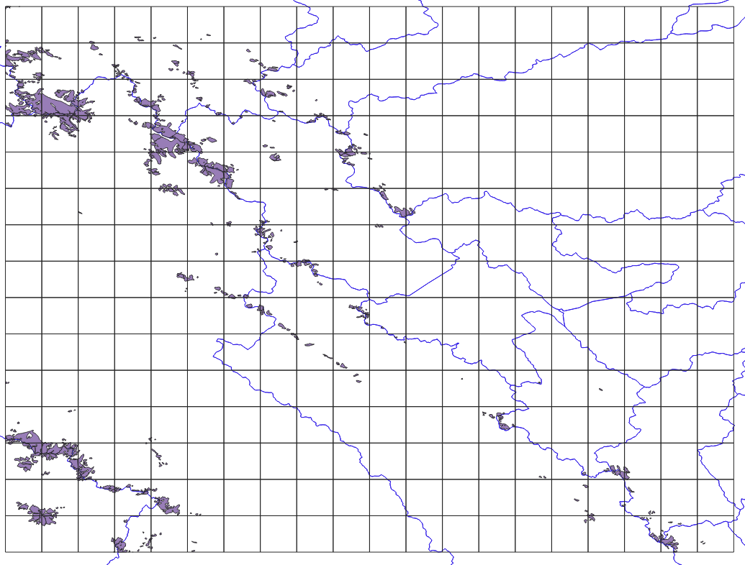
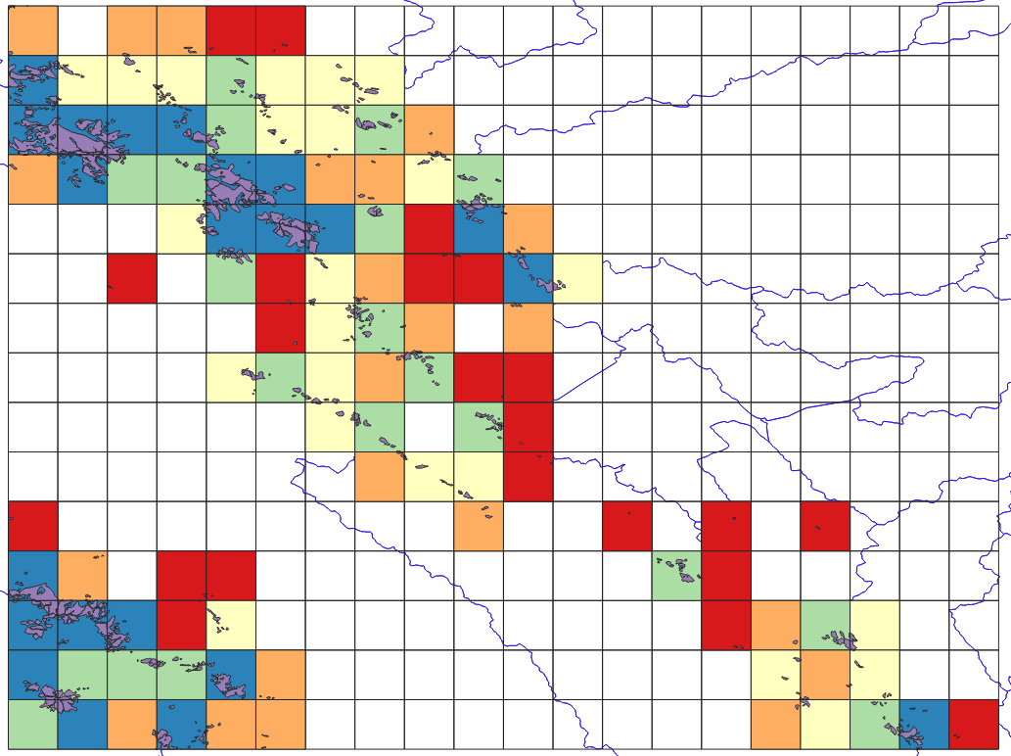

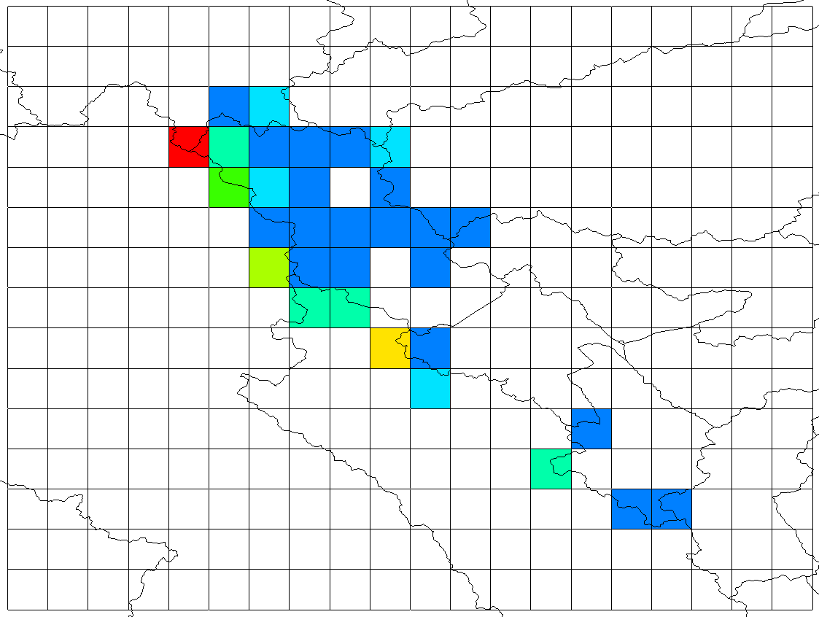
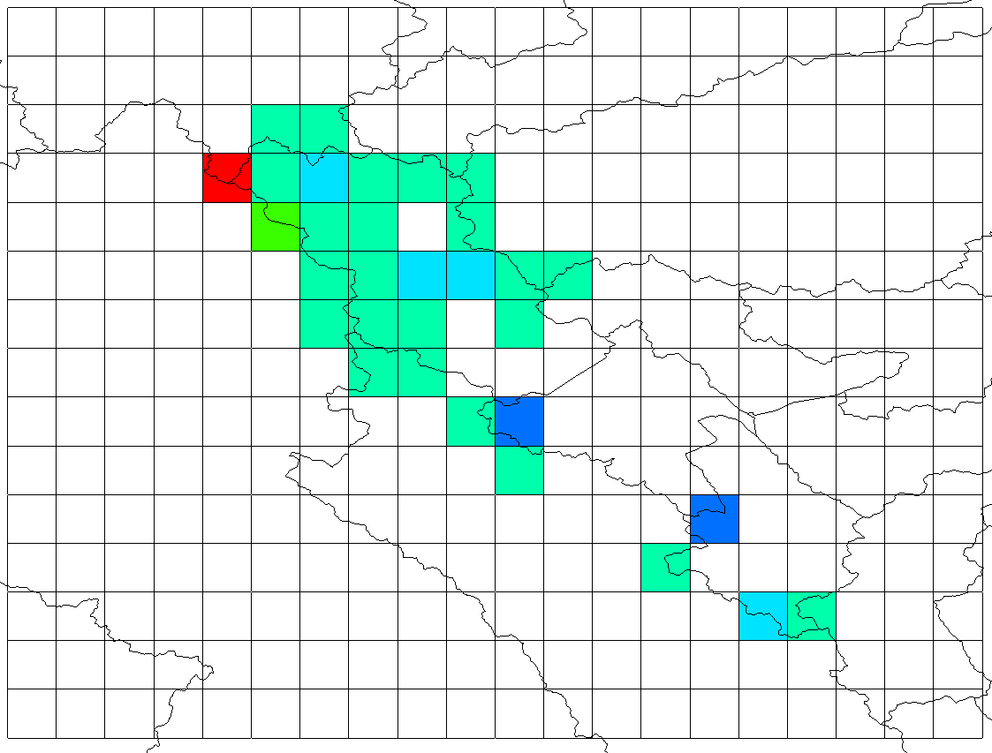
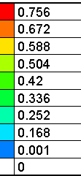
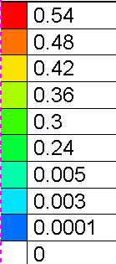
Glacier fraction based on Randolph Glacier Inventory 6.0
Shape file and grid intersection
Glacier fraction based on Randolph Glacier Inventory 6.0
Gridded fraction estimation using QGIS
Glacier fraction based on land cover data
This fraction used in the previous MESH runs
Total Glacier area = 120 km²
Glacier fraction based on Randolph 6.0
This fraction used in the new MESH runs
Total Glacier area = 45 km²

